Slide 1






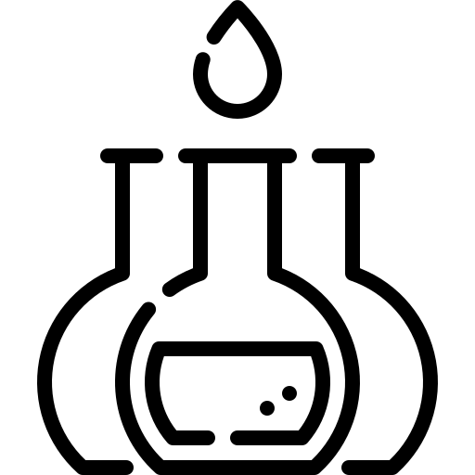


Production of FFB
FFB milling into CPO
Export & refining of CPO
Manufacturing
Material flows
CPO price signal
Number of actors at each stage
FFB price signal
Industrial plantations
Price pass-through
Smallholder plantations
Influence on expansion

Slide 2
Production
Milling
Manufacturing
Export & refining
Number of actors
Downstream material flows
Industrial plantations
Price signal
Smallholder plantations
Influence

Slide 3
Production
Milling
Manufacturing
Export & refining
Number of actors
Material flows
Industrial plantations
Price signal
Smallholder plantations

